Slide 1
DBMS LAB

Slide 2
DBMS
Database Management System (DBMS):
It is a software it helps to manage the database .
Should able to perform the following activities very easily.
1. Inserting the new data.
2. Updating the exiting data.
3. Deleting unnecessary data.
4. Retrieving the require data.

Slide 3
A database along with the software which helps to manage. The database is called database management system (DBMS).
A DBMS which is based on relational model called relational database management system.
Examples of RDBMS:
1. ORACLE
2. SQL SERVER
3. DB2
4. MYSQL
5. SYBASE
6. TERA DATA
7. MS ACCESS

Slide 4
SQL –Structured Query Language
SQL Commands:
The SQL language is subdivided according to their functions as follows
DDL - Data Definition Language
DML - Data Manipulation Language
TCL- Transaction Control Language

Slide 5
Data Definition Language (DDL):
Data Definition Language (DDL) or Schema Definition Language, statements are used to define the database structure or schema.
CREATE - to create objects in the database
ALTER - alters the structure of the database
DROP - delete objects from the database
TRUNCATE - remove all records from a table, including all spaces allocated for the records are removed
RENAME - rename an object

Slide 6
Data Manipulation Language (DML):
Data Manipulation Language (DML) statements are used for managing data within schema objects.
INSERT - insert data into a table
UPDATE - updates existing data within a table DELETE - deletes all records from a table, the space for the records
SELECT - retrieve data from the a database

Slide 7
Data Control Language (DCL):
Data Control Language (DCL) statements.
GRANT - gives user's access privileges to database REVOKE - withdraw access privileges given with the GRANT command

Slide 8
Transaction Control (TCL)
Transaction Control (TCL) statements are used to manage the changes made by DML statements.
It allows statements to be grouped together into logical transactions.
COMMIT - save work done
SAVEPOINT - identify a point in a transaction to which you can later roll back
ROLLBACK - restore database to original since the last

Slide 9
Rules
1. Oracle reserved words cannot be used.
2. Underscore, numerals, letters are allowed but not blank space.
3. Maximum length for the table name is 30 characters. 4. Two different tables should not have same name.
5. We should specify a unique column name.
6. We should specify proper data type along with width. 7. We can include “not null” condition when needed. By default it is ‘null’.
8. It is a command based language.
9. It is not case sensitive.
10. Every command should end with ‘;’.

Slide 10
SQL Operators
An operator is a reserved word or a character used primarily in an SQL statement's WHERE clause to perform operation(s), such as comparisons and arithmetic operations.
Operators are used to specify conditions in an SQL statement and to serve as conjunctions for multiple conditions in a statement.
Arithmetic operators
Comparison operators
Logical operators Operators (used to negate condition. )

Slide 11
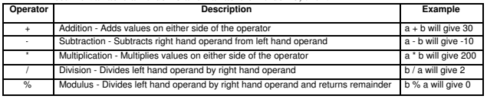
Arithmetic operator

Slide 12
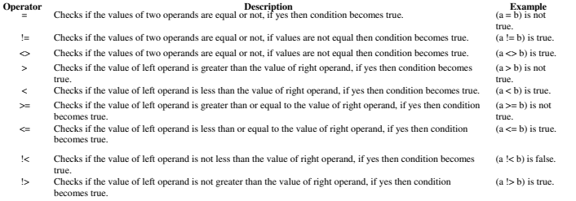
Comparison operator

Slide 13
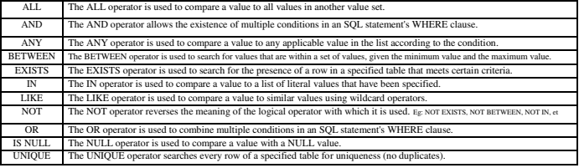
Logical operators

Slide 14
DATA TYPES
Numeric: NUMBER, NUMBER(s,p), INTEGER, INT, FLOAT, DECIMAL
Character: CHAR(n), VARCHAR(n), VARCHAR2(n)
Bit String: BLOB, CLOB
Boolean: true, false, and null

Slide 15
Table Creation
Create table
creates a table with given tablename
CREATE TABLE table_name (
column1 datatype,
column2 datatype,
....
);
Eg: CREATE TABLE employee(
empid integer,
empname varchar2(20),
salary float);

Slide 16
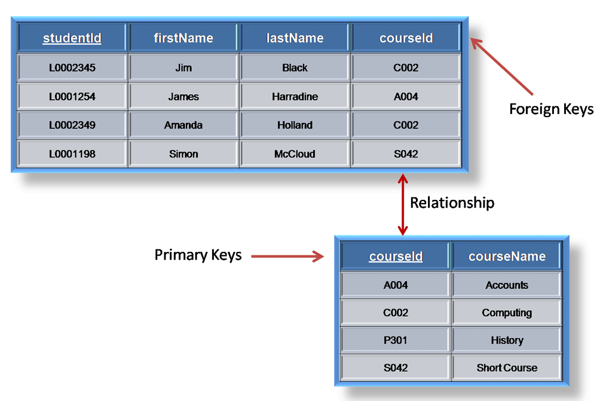
Primary key and Foreign key – We will see later…
Referencing table
Referenced table
Key in referenced table is primary key
Key in referencing table is foreign key

Slide 17
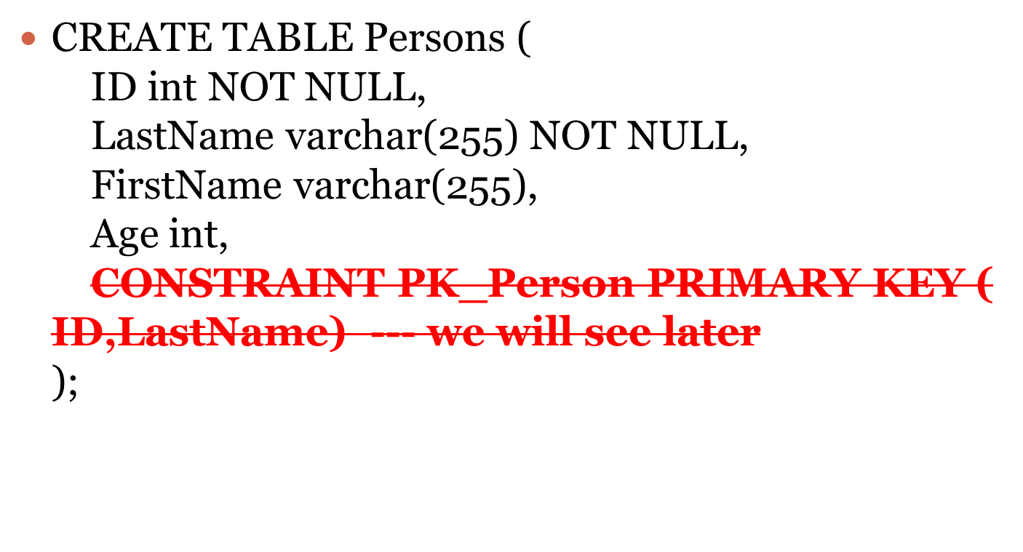
Create – primary key constraint

Slide 18
DROP TABLE
Drops the existing table
DROP TABLE table_name;
Eg: DROP TABLE employee;
Table Description
Decribes the schema of the table
DESC table_name;
Eg: DESC employee;

Slide 19
TRUNCATE TABLE
Used to delete the data inside a table, but not the table itself.
TRUNCATE TABLE table_name;
Eg: TRUNCATE TABLE employee;

Slide 20
DML .. Insert
INSERT
Used to populate the table
INSERT INTO table_name
(column1, column2, column3, ...)
VALUES (value1, value2, value3, ...);
Eg: INSERT INTO employee (empid,empname,salary)
VALUES (200,’gokul’,2300)

Slide 21
INSERT INTO table_name
VALUES (value1, value2, value3, ...);
Eg: INSERT INTO employee
VALUES (200,’gokul’,2300)
(OR)
INSERT INTO employee
VALUES( &empid,’&empname’,&salary)

Slide 22
Alter –ADD Column
ALTER TABLE - ADD Column
To add a column in a table, use the following syntax:
ALTER TABLE table_name
ADD column_name datatype;
Eg: ALTER TABLE employee
ADD Email varchar(255);

Slide 23
Alter- DROP column
To delete a column in a table, use the following syntax (notice that some database systems don't allow deleting a column):
ALTER TABLE table_name
DROP COLUMN column_name;
Eg:
ALTER TABLE employee
DROP COLUMN Email;

Slide 24
Alter modify column
ALTER TABLE table_name
MODIFY COLUMN column_name datatype;

Slide 25
Delete
DELETE FROM table_name
WHERE condition
Eg: delete from employee where empid=200;
Update:
The UPDATE statement is used to modify the existing records in a table.
UPDATE table_name
SET column1 = value1, column2 = value2, ...
WHERE condition;

Slide 26
UPDATE employee
SET empname = 'Alfred Schmidt', salary= 10000
WHERE empid= 100;

Slide 27
Queries on Single Relation
Basic “Select” Queries

Slide 28
Create a table INSTRUCTOR and insert data as shown below
ID | NAME | AGE | DEPT_NAME | SALARY
E01 | NITA | 23 | CSE | 40000
E02 | VISHAL | 29 | MECHANICAL | 45000
E03 | ANU | 30 | EEE | 35000
E04 | ABHISHEK | 35 | CSE | 50000
E05 | ARUN | 25 | EEE | 50000
E06 | AJITH | 32 | CSE | 38000
E07 | PREMA | 45 | PHYSICS | 60000
E08 | RAJANI | 48 | PHYSICS | 55000
Create table instructor (id integer, name varchar2(20), age integer, dept_name varchar2(10), salary float)

Slide 29
Basic Query Structure
The SQL data-manipulation language (DML) provides the ability to query information, and insert, delete and update tuples
A typical SQL query has the form:
select attr1,attr2..attrn
from r₁, r₂, ..., r_{m}
where condition
The result of an SQL query is a relation.
Notes:
2

Slide 30
The select Clause
The SELECT statement is used to select data from a database
Example: find the names of all instructors:
select name
from instructor
NOTE: SQL names are case insensitive (i.e., you may use upper- or lower-case letters.)
  E.g. Name ≡ NAME ≡ name
  Some people use upper case wherever we use bold font.
Notes:
3

Slide 31
The select Clause (Cont.)
SQL allows duplicates in relations as well as in query results.
To force the elimination of duplicates, insert the keyword distinct after select.
Find the names of all departments from instructor, and remove duplicates
select distinct dept_name
from instructor
The keyword all specifies that duplicates not be removed.
select all dept_name from instructor
Notes:
4

Slide 32
The select Clause (Cont.)
An asterisk in the select clause denotes “all attributes”
select *
from instructor
The select clause can contain arithmetic expressions involving the operation, +, –, ∗, and /, and operating on constants or attributes of tuples.
The query:
select ID, name, salary/12
from instructor
would return a relation that is the same as the instructor relation, except that the value of the attribute salary is divided by 12.
Notes:
5

Slide 33
The where Clause
The where clause specifies conditions that the result must satisfy
Comparison results can be combined using the logical connectives
and, or, and not.
Comparisons can be applied to results of arithmetic expressions.
To find all instructors in Comp. Sci. dept with salary > 40000
select name
from instructor
where dept_name = ‘CSE' and salary > 40000
Notes:
6

Slide 34
Operators in The WHERE Clause
Operator | Description
= | Equal
<> | Not equal. Note: In some versions of SQL this operator may be written as !=
> | Greater than
< | Less than
>= | Greater than or equal
<= | Less than or equal
BETWEEN | Between an inclusive range
LIKE | Search for a pattern
IN | To specify multiple possible values for a column

Slide 35
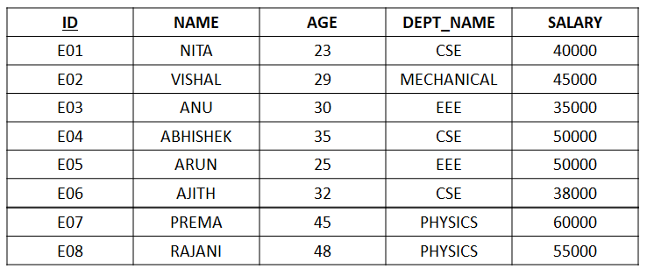
Display the details of ‘NITA’ and ‘ANU’ from the instructor table
Display the details of all instructors whose age ranges between 23 and 100
Display the details of all instructors whose age is 25

Slide 36
select * from INSTRUCTOR
where name in (‘NITA‘, ‘ANU’)
select * from INSTRUCTOR
where name not in (‘NITA‘, ‘ANU’)
select * from INSTRUCTOR
where age between 23 and 100
select * from INSTRUCTOR
where age not between 23 and 100
select * from INSTRUCTOR
where not age=25

Slide 37
LIKE Operator
LIKE Operator | Description
WHERE CustomerName LIKE 'a%' | Finds any values that start with "a"
WHERE CustomerName LIKE '%a' | Finds any values that end with "a"
WHERE CustomerName LIKE '%or%' | Finds any values that have "or" in any position
WHERE CustomerName LIKE '_r%' | Finds any values that have "r" in the second position
WHERE CustomerName LIKE 'a_%_%' | Finds any values that start with "a" and are at least 3 characters in length
WHERE ContactName LIKE 'a%o' | Finds any values that start with "a" and ends with "o"

Slide 38
ORDER BY Syntax
The ORDER BY clause orders or sorts the result of a query according to the values in one or more specific columns.
SELECT column1, column2, ...
FROM table_name
ORDER BY column1, column2, ... ASC|DESC;

Slide 39
Display the details of instructor as the ascending order of salary
Select *
from instructor
order by salary

Slide 40
Ordering by more than one columns
Display the instructor details with the following conditions:
1. Department name should be in descending order
2. Within each department salary should be in ascending order
ID | NAME | AGE | DEPARTMENT | SALARY
E08 | RAJANI | 48 | PHY | 55000
E07 | PREMA | 45 | PHY | 60000
E02 | VISHAL | 29 | MECH | 45000
E03 | ANU | 30 | EEE | 35000
E05 | ARUN | 25 | EEE | 50000
E06 | AJITH | 32 | CSE | 38000
E01 | NITA | 23 | CSE | 40000
E04 | ABHISHEK | 35 | CSE | 50000

Slide 41
Ordering by more than one columns
Display the instructor details with the following conditions:
1. Department name should be in descending order
2. Within each department salary should be in ascending order
ID | NAME | AGE | DEPARTMENT | SALARY
E08 | RAJANI | 48 | PHY | 55000
E07 | PREMA | 45 | PHY | 60000
E02 | VISHAL | 29 | MECH | 45000
E03 | ANU | 30 | EEE | 35000
E05 | ARUN | 25 | EEE | 50000
E06 | AJITH | 32 | CSE | 38000
E01 | NITA | 23 | CSE | 40000
E04 | ABHISHEK | 35 | CSE | 50000
SELECT *
FROM INSTRUCTOR
ORDER BY DEPNAME DESC,SALARY;

Slide 42
Aggregate Functions
These functions operate on the multiset of values of a column of a relation, and return a value
avg: average value
min: minimum value
max: maximum value
sum: sum of values
count: number of values

Slide 43
Aggregate Functions (Cont.)
Find the average salary of instructors in the Computer Science department
  select avg (salary)
  from instructor
  where dept_name= ’Comp. Sci.’;
Find the number of tuples in the instructor relation
  select count (*) from instructor;
Display the count of instructors in each department
DEPT | DEPT_COUNT
PHY | 2
EEE | 2
CSE | 3
MECH | 1

Slide 44
GROUPBY Syntax
Display the count of instructors in each department
ID | NAME | AGE | DEPNAME | SALARY
E08 | RAJANI | 48 | PHY | 55000
E07 | PREMA | 45 | PHY | 60000
E02 | VISHAL | 29 | MECH | 45000
E03 | ANU | 30 | EEE | 35000
E05 | ARUN | 25 | EEE | 50000
E06 | AJITH | 32 | CSE | 38000
E01 | NITA | 23 | CSE | 40000
E04 | ABHISHEK | 35 | CSE | 50000
SELECT column_name(s)
FROM table_name
WHERE condition
GROUP BY column_name(s)
Select depname as dept,count(*) as dept_count
from instructor
group by depname;

Slide 45
Display the count of instructors in each department as dept_count and order the output as the ascending order of department name
ID | NAME | AGE | DEPNAME | SALARY
E08 | RAJANI | 48 | PHY | 55000
E07 | PREMA | 45 | PHY | 60000
E02 | VISHAL | 29 | MECH | 45000
E03 | ANU | 30 | EEE | 35000
E05 | ARUN | 25 | EEE | 50000
E06 | AJITH | 32 | CSE | 38000
E01 | NITA | 23 | CSE | 40000
E04 | ABHISHEK | 35 | CSE | 50000
DEPT | DEPT_COUNT
CSE | 3
EEE | 2
MECH | 1
PHY | 2
Select depname as dept,count(*) as dept_count
from instructor
group by depname
Order by depname ;

Slide 46
The from Clause
The from clause lists the relations involved in the query
  Corresponds to the Cartesian product operation of the relational algebra.
Find the Cartesian product instructor X teaches
select ∗
from instructor, teaches
  generates every possible instructor – teaches pair, with all attributes from both relations
Cartesian product not very useful directly, but useful combined with where-clause condition (selection operation in relational algebra)
Notes:
8

Slide 47
